Slide 1

Blood Relation

Slide 2
Definition and Concept
Blood Relations mean persons of a family connected by relationships like father-mother, son-daughter, brother-sister, grandfather-grandmother, uncle-aunty, nephew-niece, brother-in-law - sister-in-law etc. In other words, it represents the Family Tree.
Questions in Test of Reasoning on Family/Blood Relationship are about the relationship of a particular person with another person of the family, based on the chain of relationships between other members of that family.
Family/Blood Relation Tests are an exercise to test the student’s ability to comprehend and come to the crux of an issue from complex, lengthy and even confusing data.

Slide 3
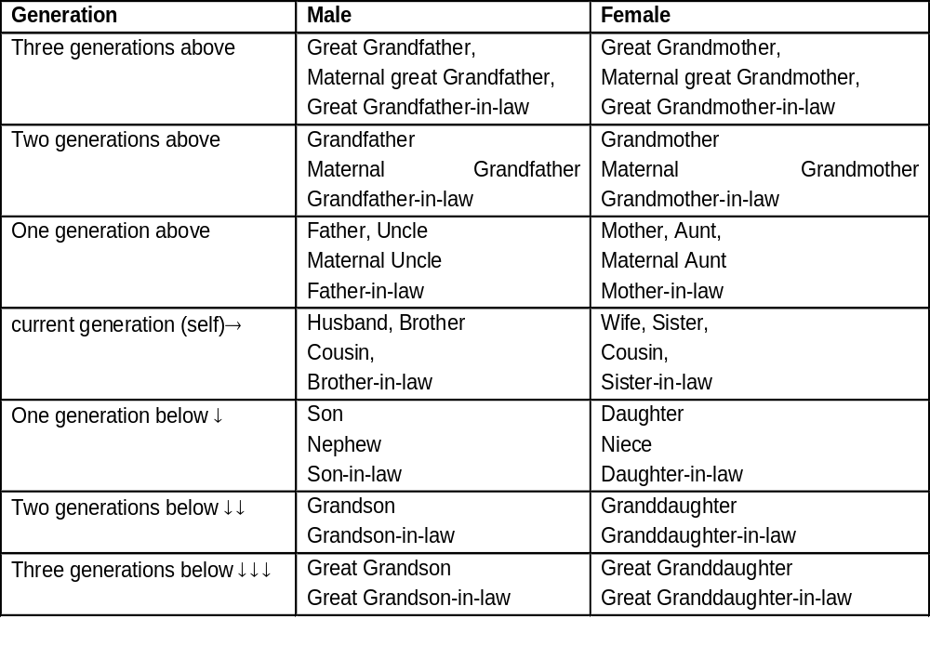

Slide 4
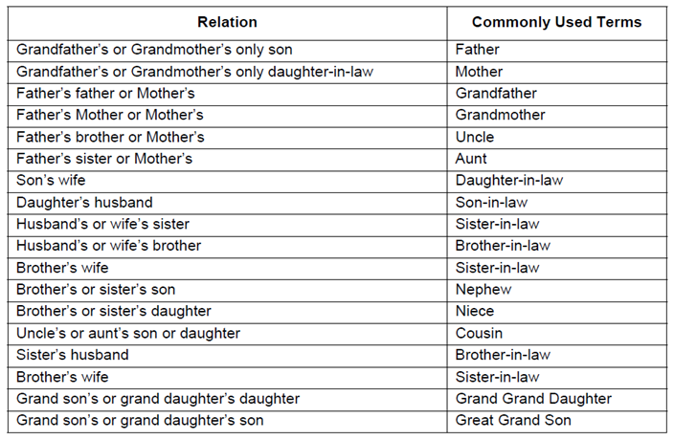

Slide 5
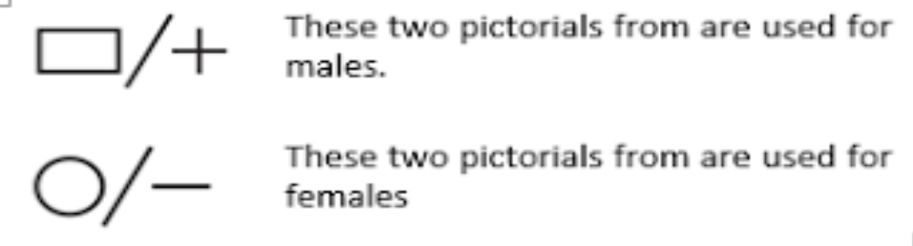
The questions of Blood Relations can be solved easily with the help of ―Generation Tree.
Different pictorial form, which are used to define the relationship among them.

Slide 6
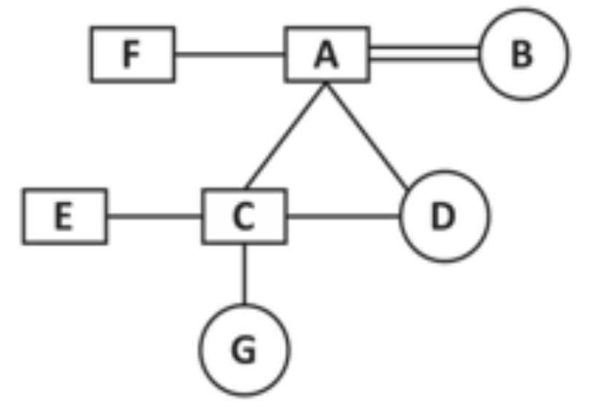
From given generation tree we can deduce some important relationship between family members:
1. A is Father of C, E and D
2. B is Mother of C, E and D
3. F is Brother of A
4. F is Brother in law of B
5. A is Husband of B
6. B is Wife of A
7. F is Uncle of E, C and D
8. C and E are Son of A and B
9. D is Daughter of A and B
10. D is Sister of E and C
11. E is Brother of C and D
12. C is Brother of E and D
13. A is Grandfather of G
14. B is Grandmother of G
15. G is Granddaughter of A and B.

Slide 7
Types of questions asked from Blood Relations:
1. Based on Dialogue or Conversation
2. Based on Symbolically coded
3. Based on Puzzles

Slide 8
TYPE 1: Based on Dialogue or Conversation
1. Introducing Neeta, Anil said "She is the wife of my mother's only child'". How is Neeta related to Anil?
Solution :
Neeta is the wife of Anil's mother's only son, who is Anil himself. Hence, the answer is Neeta is Anil's wife.

Slide 9
2. 'Ram' is the father of 'Kusha' but 'Kusha' is not his son. 'Mala' is the daughter of 'Kusha'. 'Shalaka' is the spouse of 'Ram'. 'Gopal' is the brother of 'Kusha'. 'Hari' is the son of 'Gopal'. 'Meena' is the spouse of 'Gopal'. 'Ganpat' is the father of 'Meena'. Who is the grand daughter of 'Ram'?
Solution:
'Mala' is the daughter of 'Kusha' and 'Ram' is the father of 'Kusha'. So, 'Mala' is the granddaughter of 'Ram‘.

Slide 10
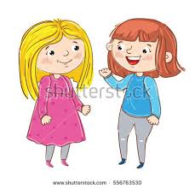
3. Soni, who is Dubey’s daughter, say to Preeti, “Your mother Shyama is the youngest sister of my father, who is third child of Prabhat.” How is Prabhat related to Preeti?
Uncle
Father
Grandfather
None
Ans: D

Slide 11

4. Pointing to a woman in a photograph, a man said,” the son of her sister’s father is the maternal uncle of my son.” how is the sister of the woman is related to the son of the man?
Mother
Mother or mother’s sister
Mother’s sister
Aunt
Ans: b) Mother or mother’s sister

Slide 12
TYPE 2: Based on Symbolically coded
5. ‘ P +Q’ means that P is the son of Q, ‘P-Q’ means that P is the wife of Q, ‘P*Q’ means that P is the brother of Q, ‘P/Q’ means that P is the mother of Q and ‘P=Q’ means that P is the sister of Q. then, what does X+Y-Z mean?
Z is the father of X
Z is the son of X
Z is the uncle of X
Z is the brother of X
Ans: a) Z is the father of X

Slide 13
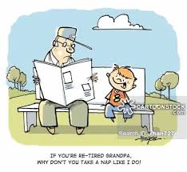
Direction for Q6 & Q7: Study the following information carefully to answer these questions.
(a) ‘A$B’ means ‘A is mother of B’
(b) ‘A#B’ means ‘A is the father of B’
(c) ‘A@B’ means ‘A is the husband of B’
(d) ‘A%B’ means ‘A is daughter of B’
6. P@Q$M#T indicates what relationship of P with T?
Maternal Grandfather
Maternal Grandmother
Paternal Grandfather
None of the above
Ans: c) Paternal Grandfather

Slide 14
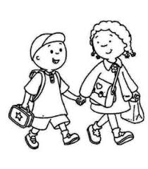
7. Which of the following expressions indicates ‘R is the sister of H’?
R$D@F#H
H%D@F$R
R%D@F$H
H$D@F#R
Ans: c) R%D@F$H

Slide 15
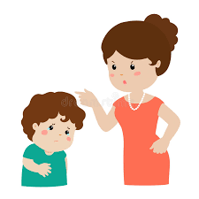
TYPE 3: Based on Puzzles
8. A is the mother of B. B is the sister of C. D is the son of C. E is the brother of D. F is the mother of E. H has only two children B and C. How is F related to E?
Mother
Father
Mother-in-law
Aunt

Slide 16

PRACTICE QUESTIONS
Neelam, who is Rohit’s daughter, says to Indu,” Your mother Reeta is the youngest sister of my father, who is the third child of Mr.Sohanji.” How is Sohanji related to Indu?
Maternal Uncle
Father
Grandfather
Father-in-law
Ans: c) Grandfather

Slide 17
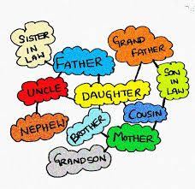
2. If Neha says, "Amrita's father Raj is the only son of my father-in-law Mahesh,” then how Bindu, who is the sister of Amrita related to Mahesh?
Daughter
Wife
Niece
None of these
And: d)None of these
Grand daughter

Slide 18
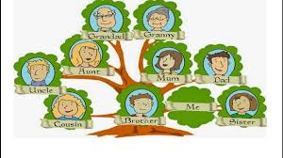
3. Poonam said to her friend, “Yesterday I attended the birthday party of the son of the only son-in-law of my mother’s mother.” How is Poonam related to the man, whose birthday party she attended?
Niece
Daughter
Sister
Mother
Ans: c)Sister

Slide 19
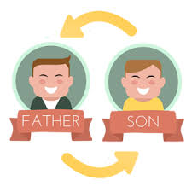
4. A woman walking with a boy meets another woman and on being asked about her relationship with the boy, she says, “My maternal uncle and his maternal uncle’s maternal uncle are brothers.” How is the boy related to the woman?
Nephew
Son
Brother-in-law
Grandson
Ans: b)Son

Slide 20
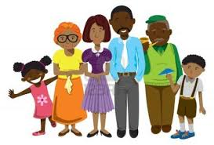
5. The son of M is the father of N and grandfather ( mother’s father )of R. S is the daughter of N and sister of B. How is M related to B?
Grand father
Grand mother
Grandmother’s mother
Grandfather’s father
Data inadequate
Ans: e) Data inadequate

Slide 21
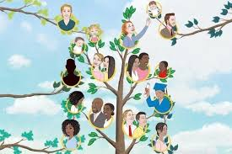
6. A told B, “Yesterday I met the only brother of the daughter of my grandmother”. Whom did A met?
Cousin
Brother
Nephew
Son
Father
Ans:e) Father

Slide 22
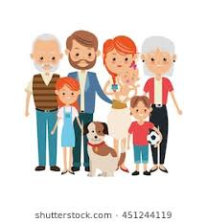
7. Showing the lady in the park, Vineeth said, “She is the daughter of my grandfather’s only son”. How is Vineeth related to that lady?
Brother
Grand father
Father
Uncle
Ans: a) Brother

Slide 23

8. P is the brother of Q and R. S is R’s mother. T is P’s father. Which of the following statements cannot be definitely true?
Q is T’s son
T is Q’s father
S is P’s mother
P is S’s son
T is S’s husband
Ans: a) Q is T’s son

Slide 24

9. Pointing a lady, a man said, “The son of her only brother is the brother of my wife”. How is the lady related to that man?
Mother’s sister
Grand mother
Sister of Father-in-law
Mother-in-law
Maternal uncle
Ans: C

Slide 25
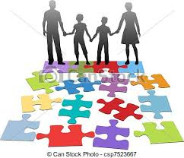
10. A is the brother of B, C is the brother of A. To establish a relationship between B and C, which of the following information is required?
Gender of C (ii) Gender of B
Only i is required
Only ii is required
Both i and ii are required
Neither i nor ii is required
Ans: b) Only ii is required

Slide 26
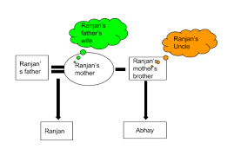
11. In a beach, Rina is walking with her children's and there she met Samuel and Susan. Samuel introduces Susan to those children as “this person is the daughter of your mother’s father’s mother and is my sister. How is Samuel and Susan related to Rina?
Brother, sister
Uncle, aunt
Cousin, aunt
None of these
Ans: b) Uncle, aunt

Slide 27
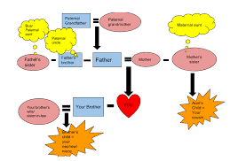
12. A party consists of grandmother, father, mother, four sons and their wives and one son and two daughters to each of the sons. How many females are there in all?
14
18
12
16
Ans: a)14

Slide 28
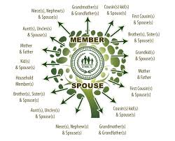
13. In Mr. Mehta’s family, there are one grandfather, one grandmother, two fathers, two mothers, one father-in-law, one mother-in-law, four children, three grandchildren, one brother, two sisters, two sons, two daughters and one daughter-in-law. How many members are there in Mr. Mehta’s family?
17 members
23 members
25 members
7 members
Ans: 7 members

Slide 29

14. In one family there are several children in which each girl has as many brothers as she has sisters but each boy has sisters which are twice of brothers he has. Then how many brothers and sisters are there?
4 Brothers, 3 sisters
4 sisters, 3 brothers
4 brothers, 4 sisters
Cannot say
Ans: b) 4 sisters, 3 brothers

Slide 30
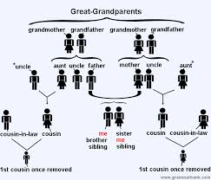
15. Pointing out to a lady, Rajan said, “She is the daughter of the woman who is the mother of the husband of my mother”. Who is that lady to Rajan?
Aunt
Grand daughter
Daughter
Sister
Ans: a) Aunt

Slide 31


